Slide 1

Sum of subsets

Slide 2

The SUBSET-SUM problem involves determining whether or not a subset from a list of integers can sum to a target value.
For example, consider the list of nums = [1, 2, 3, 4].
If the target = 7, there are two subsets that achieve this sum: {3, 4} and {1, 2, 4}.
If target = 11, there are no solutions.

Slide 3
Introduction –sum of subset problem
Given n -positive numbers (usually called weights)
Find all combinations of these numbers whose sum is m
Can represent the the problem either as
Fixed size tuples
Variable size tuples
Here we are considering fixed size tuples
Each Xi in the solution vector can be either 1 or 0 depending on whether weight Wi included or not

Slide 4
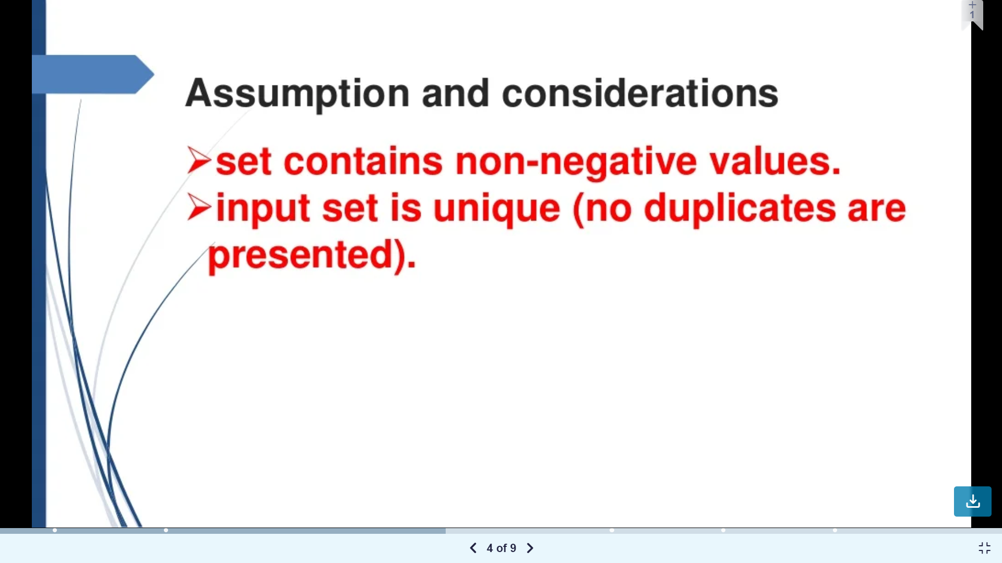

Slide 5
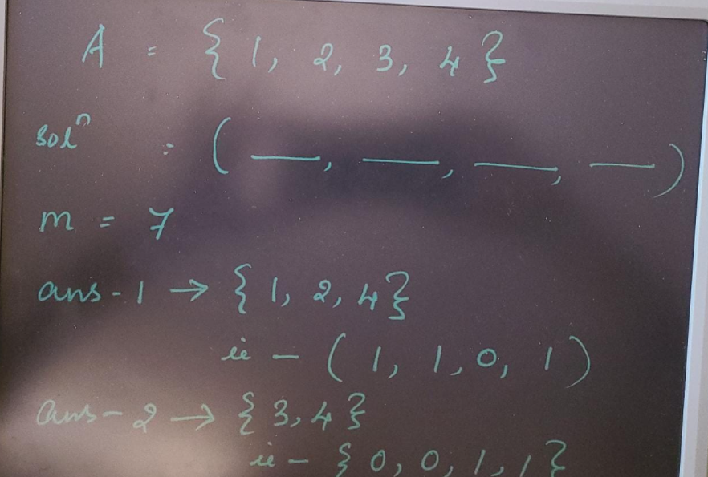

Slide 6
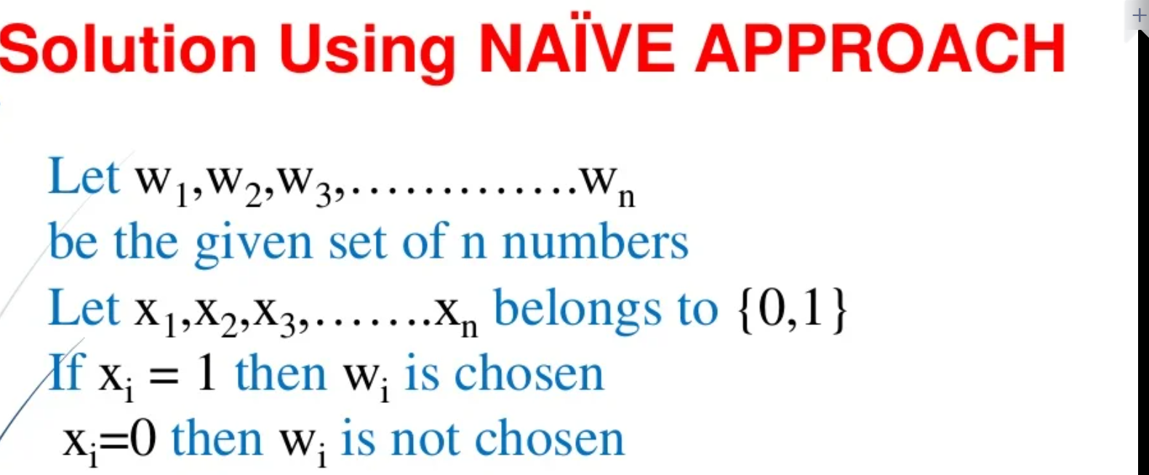

Slide 7
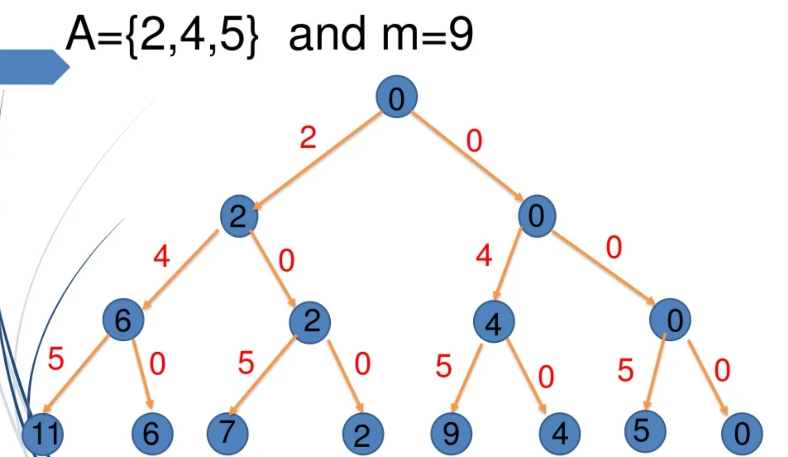

Slide 8
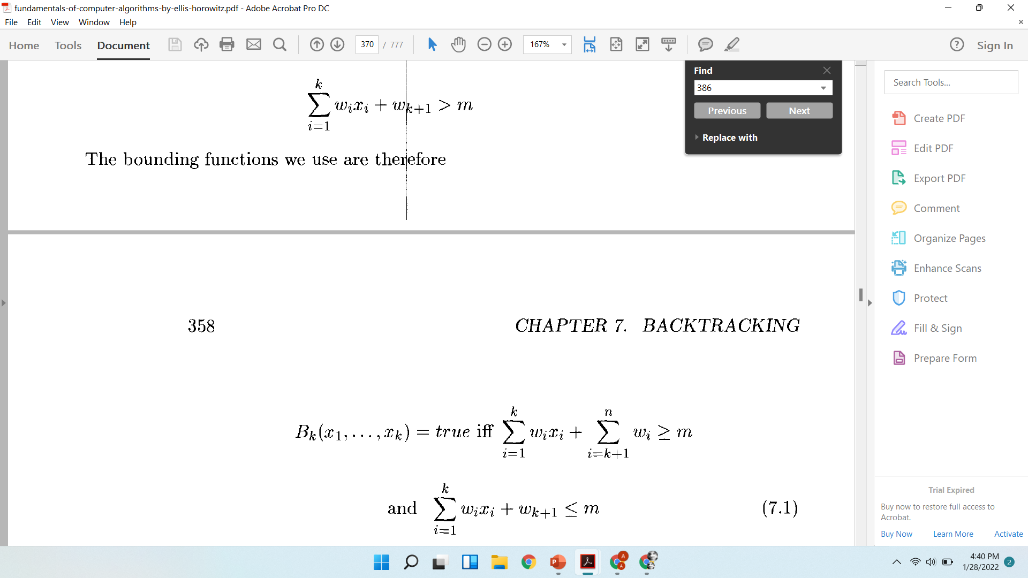
The bounding functions are

Slide 9

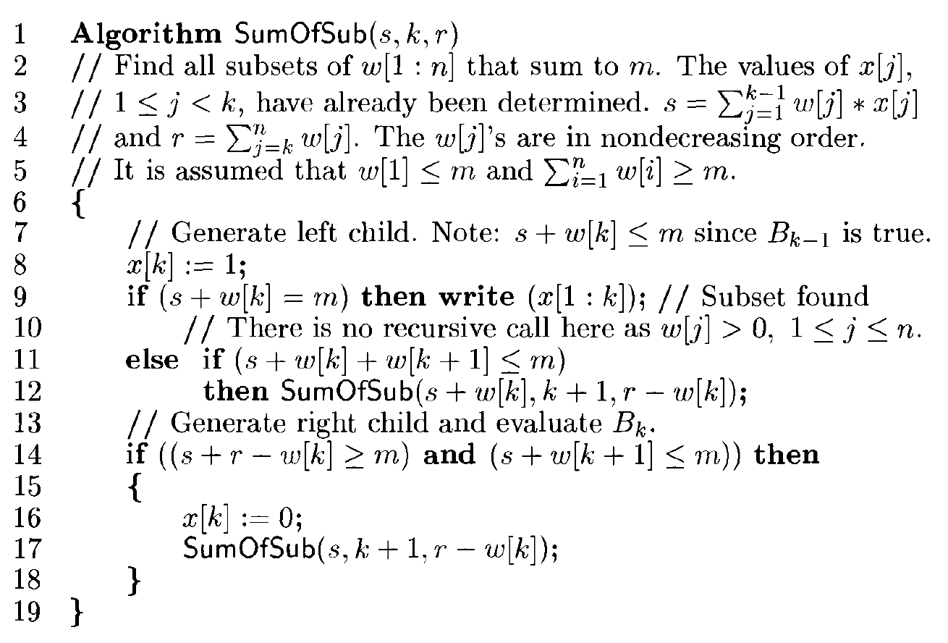

Slide 10
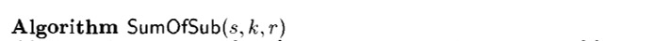
Example 1
A={1,2,3,4} m= 7
Iteration of algorithm
Line 1
Initial parameters(s=0,k=1,r= 1+2+3+4)

Slide 11
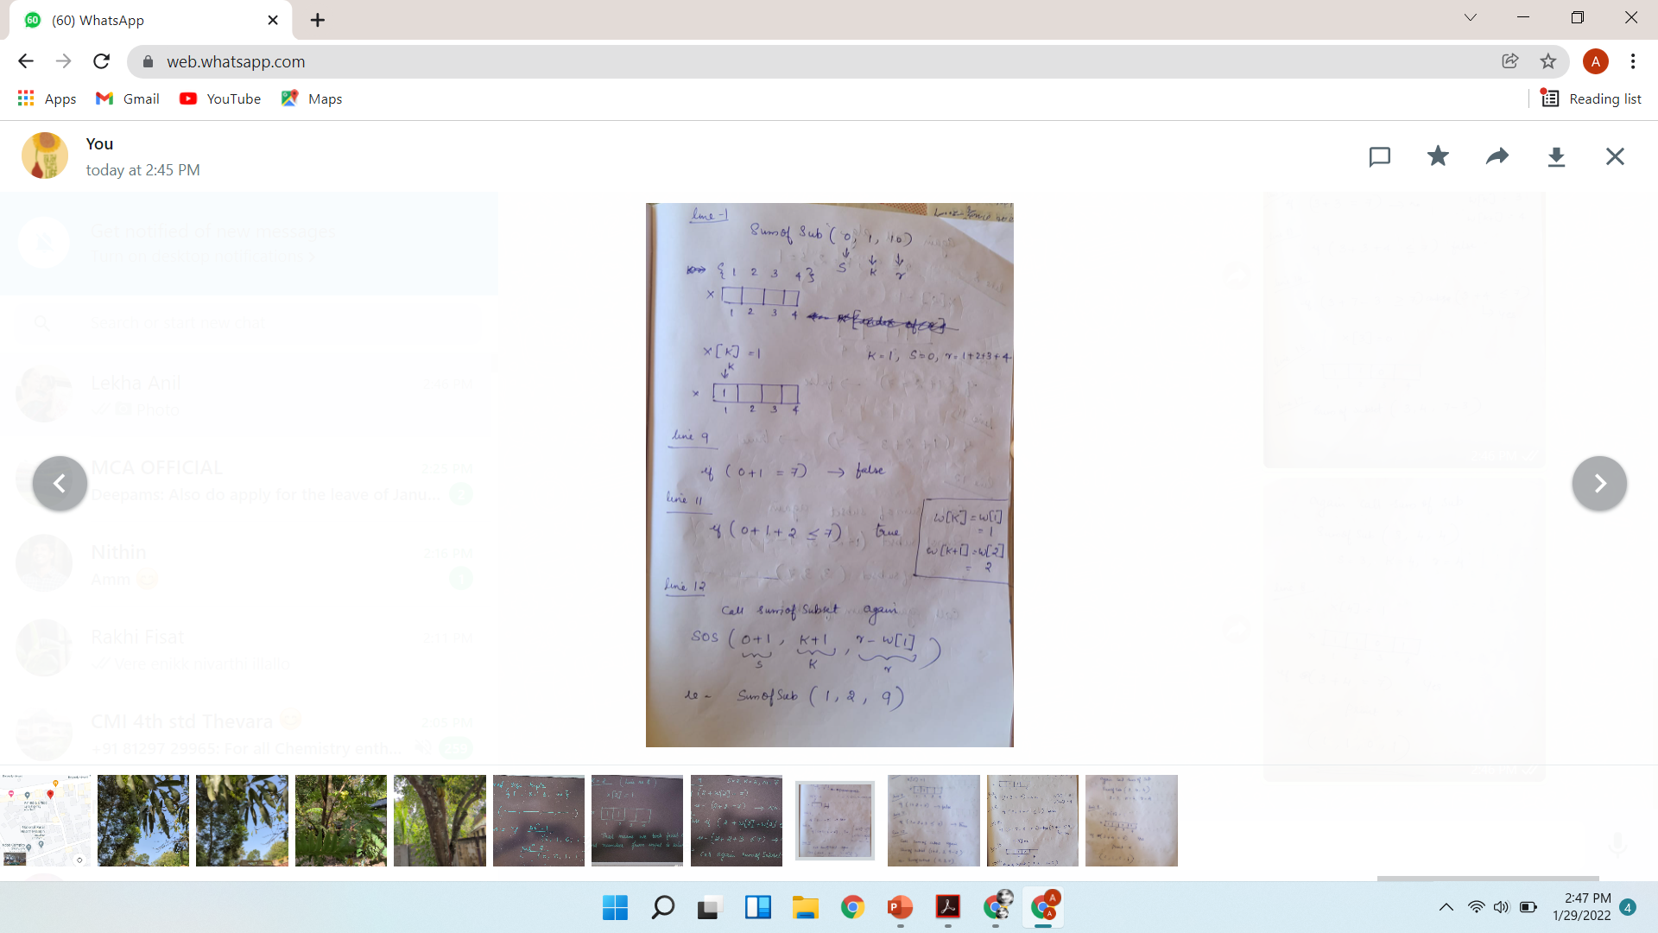
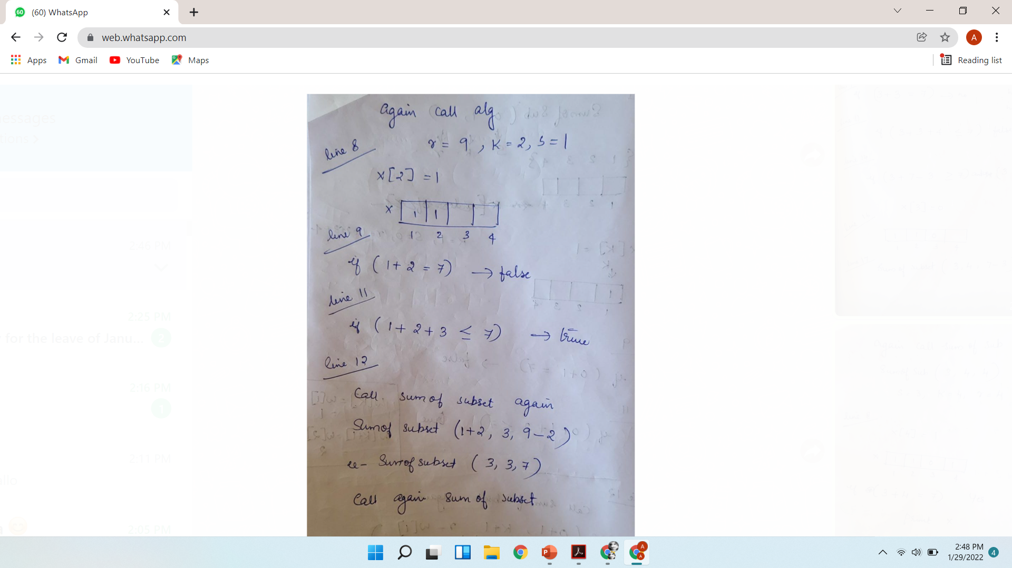

Slide 12
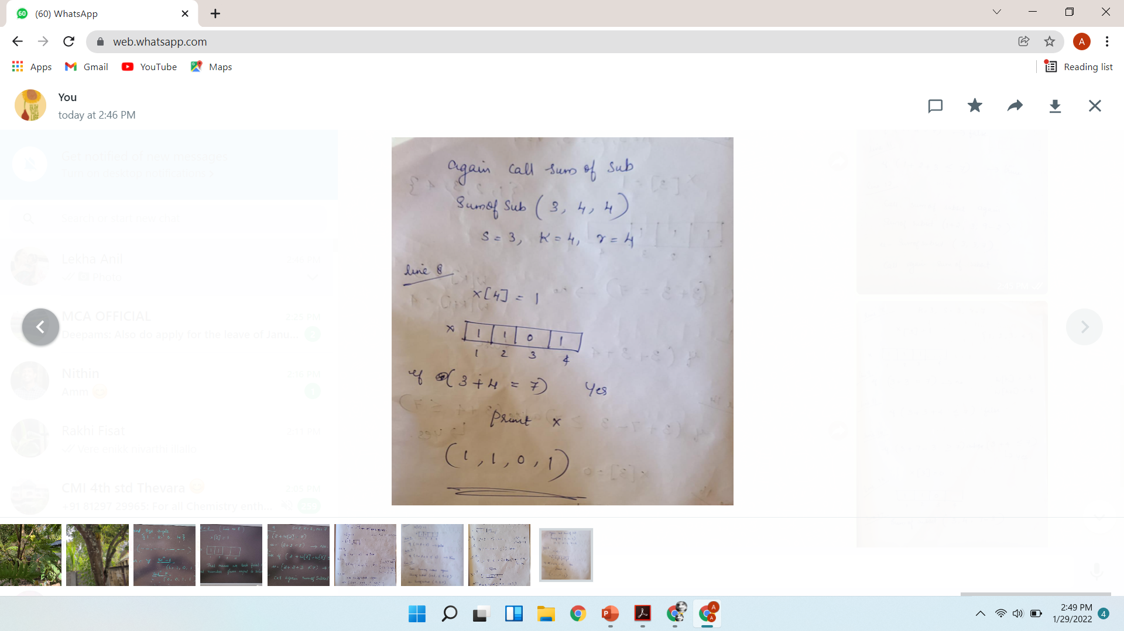
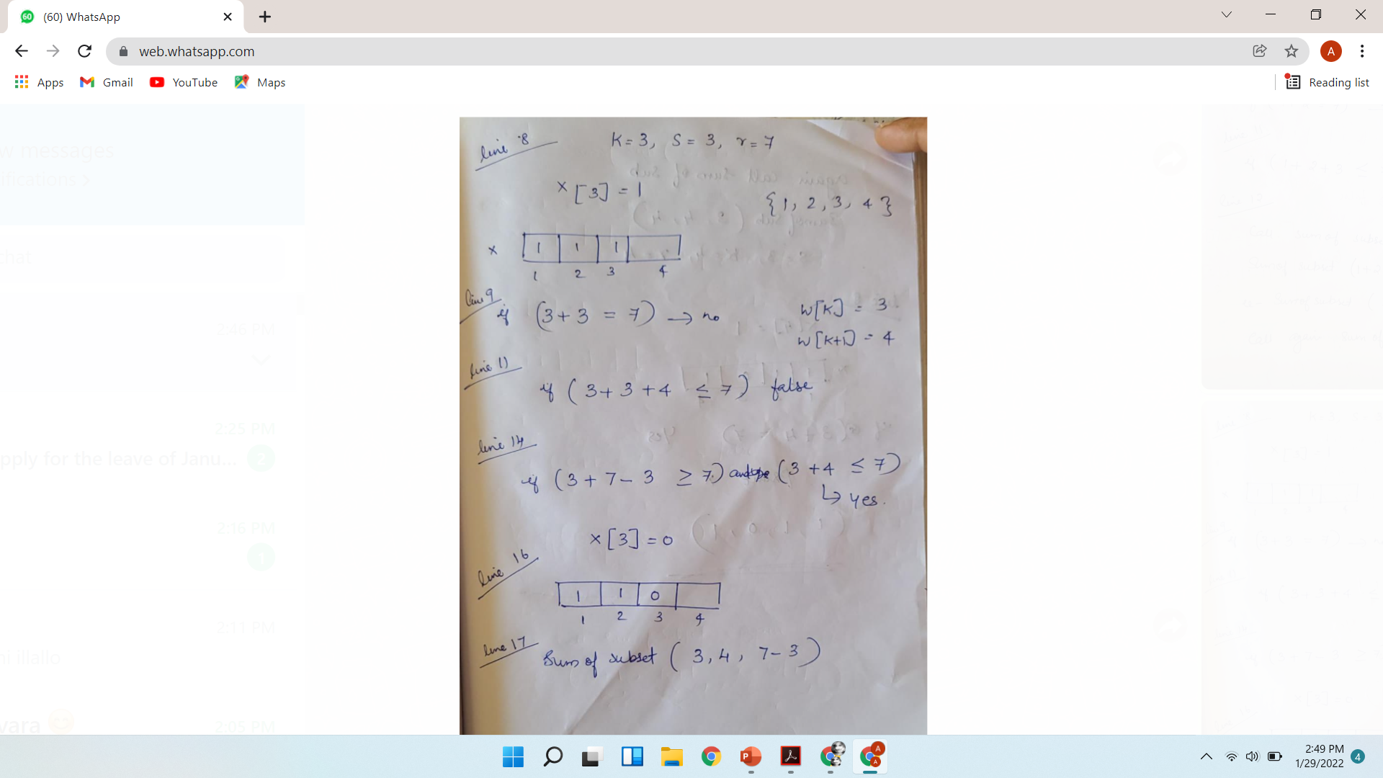

Slide 14
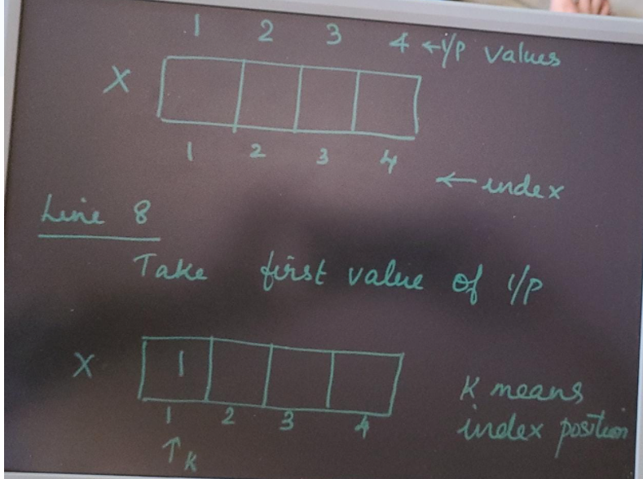

Slide 15
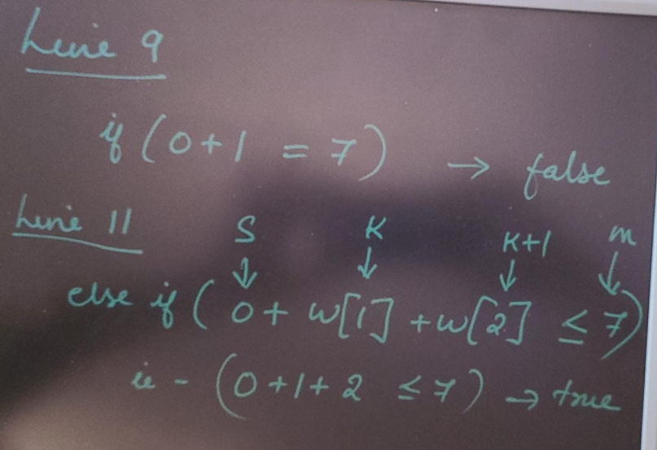

Slide 16
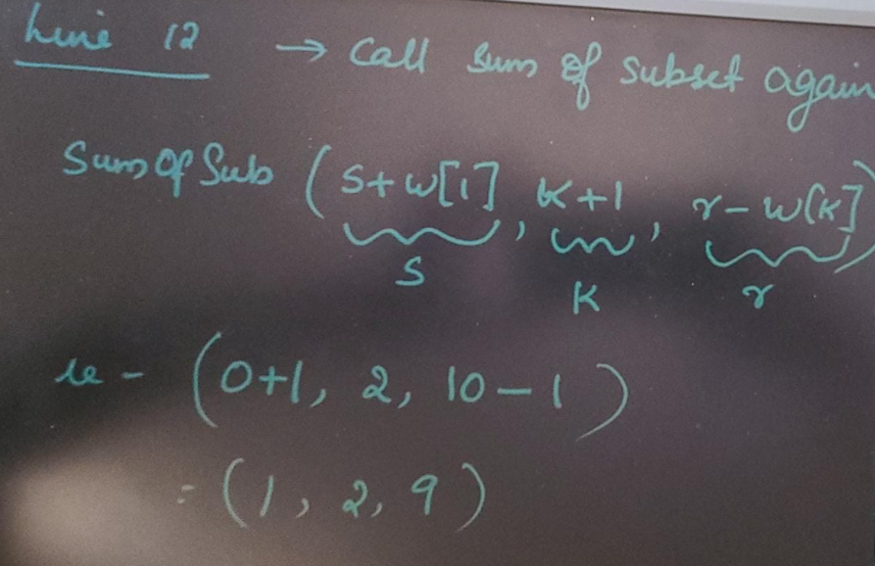

Slide 17
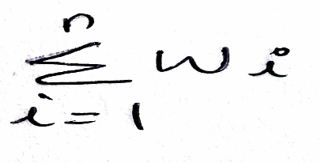
Example
N=6, m=30
W[1..6] {5,10,12,13,15,18}
Initial call to algorithm is
Sum Of Sub(0,1 , )

Slide 18
Problem 2
Let n = 4
(w1,w2,w3,w4)=(11,13,24,7) m=31
Ans={11,13,7}
{24,7}

